Slide 1
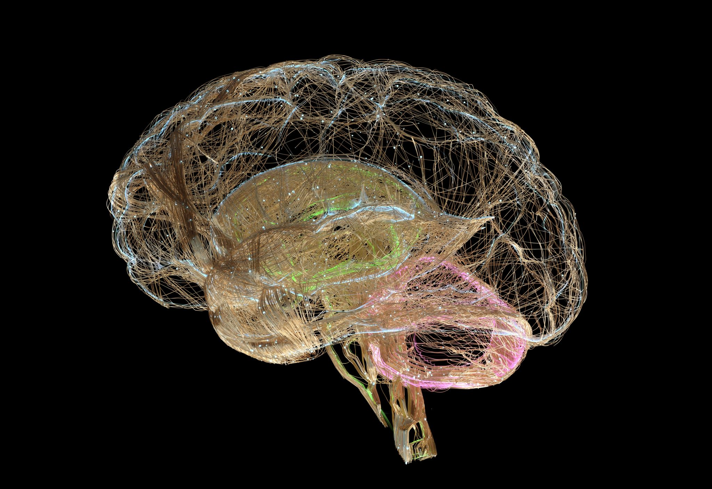
AI-Based Brain Tumor Classification from MRI
Mohamed Khaled
TM471 – Final Year Project
Supervisor: Dr. Amira Abdelfatah

Slide 2
Problem Statement
Manual MRI interpretation is time-consuming and demanding.
Public academic datasets are limited to 2D slices with no segmentation masks.
Many AI models act as black boxes with limited interpretability.

Slide 3
Suggested Solution
Develop a lightweight CNN-based classification system for 2D MRI slices.
Classify images into four classes: Glioma, Meningioma, Pituitary, No Tumor.
Integrate Grad-CAM for built-in visual explainability.
Focus on feasibility, transparency, and reproducibility rather than clinical deployment.

Slide 4
Project Objectives
Prepare and preprocess public 2D MRI datasets.
Design and evaluate a custom CNN architecture.
Apply MobileNetV2 as a lightweight transfer learning benchmark.
Integrate Grad-CAM to visualize model decision regions.
Evaluate performance using standard classification metrics.

Slide 5
Background
MRI is the primary modality for brain tumor diagnosis.
Deep learning has shown strong performance in medical image classification.
Most academic datasets limit research to image-level classification.

Slide 6
Related Work – Classification Models
CNN-based models dominate MRI tumor classification research.
Lightweight architectures achieve competitive accuracy.
Transfer learning mitigates limited dataset size.

Slide 7
Related Work – Explainability
Medical AI systems require interpretability to build trust.
Grad-CAM is widely used for CNN-based visual explanations.
Many studies treat explainability as post-hoc rather than integral.

Slide 8
Related Works - summary table
Work | Task | Data Type | Model Strategy | Explainability | Key Insight
Haque et al. (2024) | Classification | 2D MRI | VGG19-based CNN | LIME | High accuracy achievable with slice-based data
Reyes & Sánchez (2024) | Classification | 2D MRI | CNN + transfer learning | None | Lightweight models rival deep architectures
Almusharraf et al. (2024) | Classification | 2D MRI | Custom CNN | Grad-CAM | Explainability improves trust under constraints
Vimala et al. (2023) | Classification | 2D MRI | EfficientNet | Grad-CAM | Efficiency and performance can coexist
Rasa et al. (2024) | Classification | 2D MRI | MobileNetV2 et al. | None | MobileNetV2 balances accuracy and efficiency
Nazir et al. (2024) | Classification | 2D MRI | Custom CNN | Grad-CAM, SHAP, LIME | Transparency is critical even for simple tasks
Segmentation Studies | Segmentation | 3D MRI + masks | U-Net variants | Limited | Data assumptions unsuitable for public datasets
Present Project | Classification | 2D MRI | Custom CNN + MobileNetV2 | Grad-CAM (integrated) | Constraint-aware, explainable, reproducible

Slide 9
Methodology
Dataset: Public 2D brain MRI slices.
Preprocessing: Resizing, normalization, grayscale handling.
Models: Custom CNN and MobileNetV2.
Explainability: Grad-CAM heatmap generation.
Evaluation: Accuracy, precision, recall, F1-score.

Slide 10
Functional Requirements
Accept individual 2D brain MRI images in standard formats (e.g., PNG, JPEG).
Preprocess input images using resizing, normalization, and grayscale handling where applicable.
Classify each MRI image into one of four categories: glioma, meningioma, pituitary tumor, or no tumor.
Support classification using two models: a custom CNN and a MobileNetV2-based transfer learning model.
Generate class-specific visual explanations using Grad-CAM.
Produce combined image–heatmap overlays for interpretability.
Display prediction results, including class label and confidence score.
Compute evaluation metrics including accuracy, precision, recall, F1-score, and confusion matrices.

Slide 11
Non-Functional Requirements
Interpretability: The system shall provide explainable outputs using integrated Grad-CAM visualization.
Efficiency: The system shall operate within computational limits suitable for academic hardware.
Reliability: The system shall produce consistent results for identical inputs and configurations.
Reproducibility: Fixed dataset splits, preprocessing steps, and training settings shall be used.
Maintainability: The system shall follow a modular design separating preprocessing, modeling, explainability, and evaluation.
Ethical Compliance: The system shall operate only on de-identified, publicly available data.
Portability: The design shall support deployment within lightweight desktop or mobile interfaces.

Slide 12
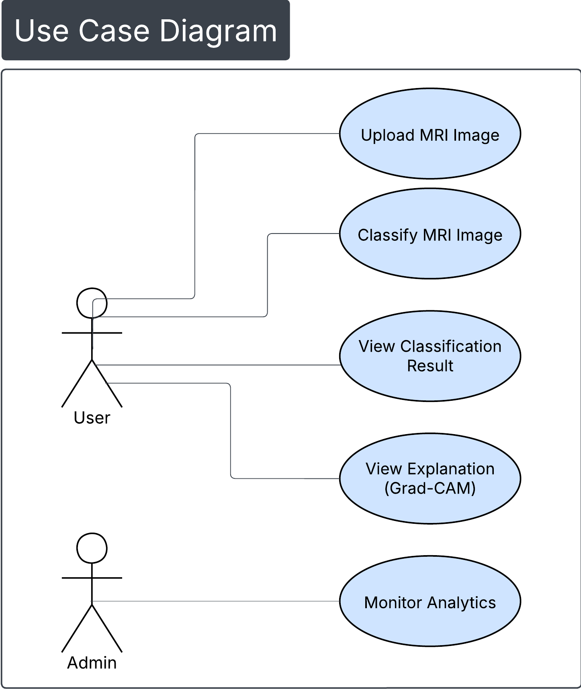
UML Diagram – USE CASE

Slide 13
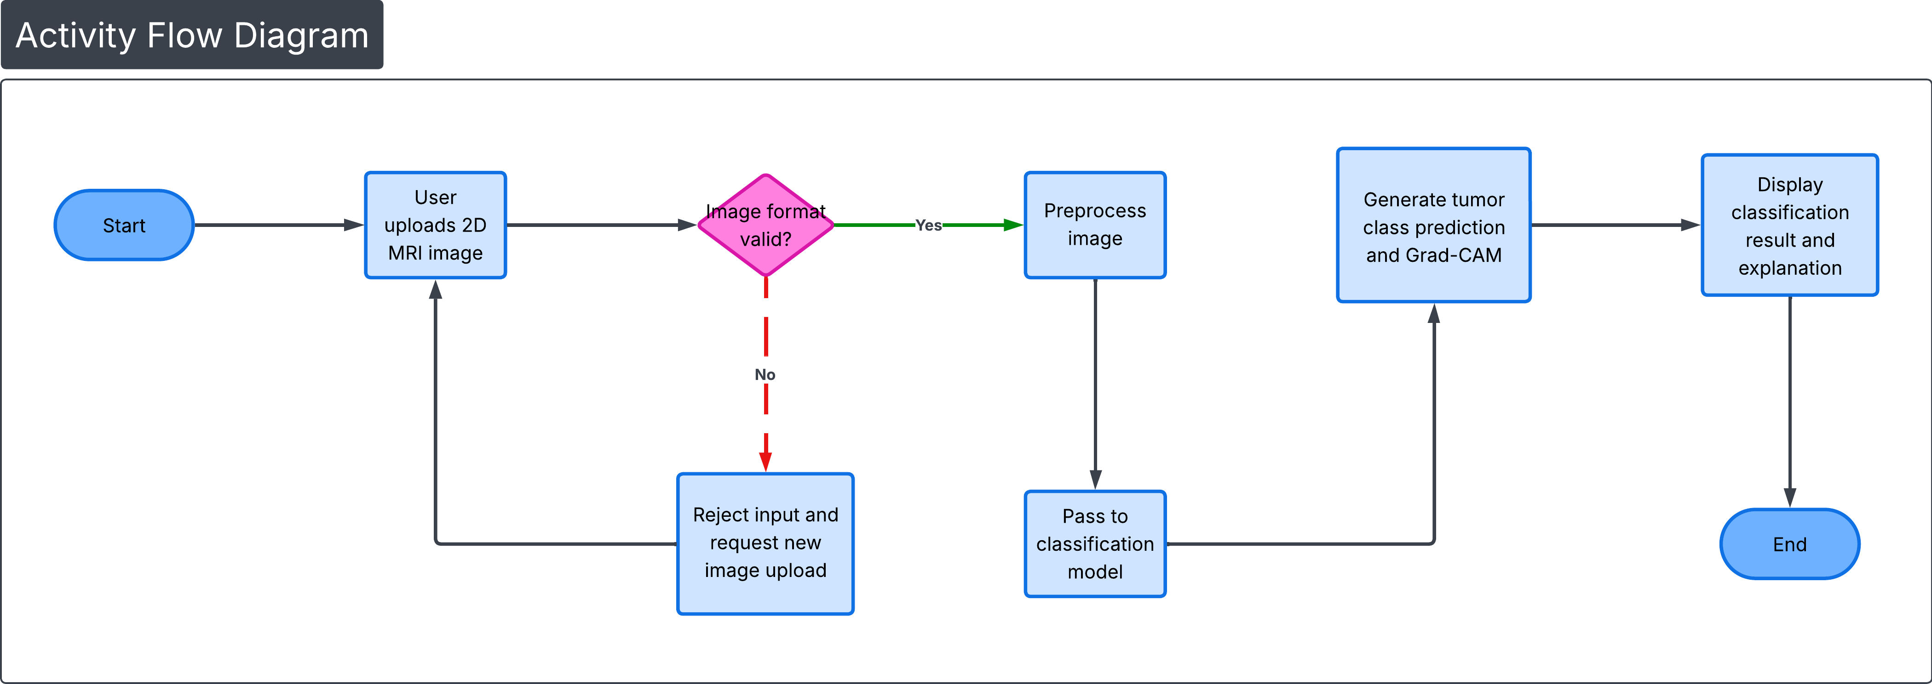
UML Diagram – Activity flow

Slide 14
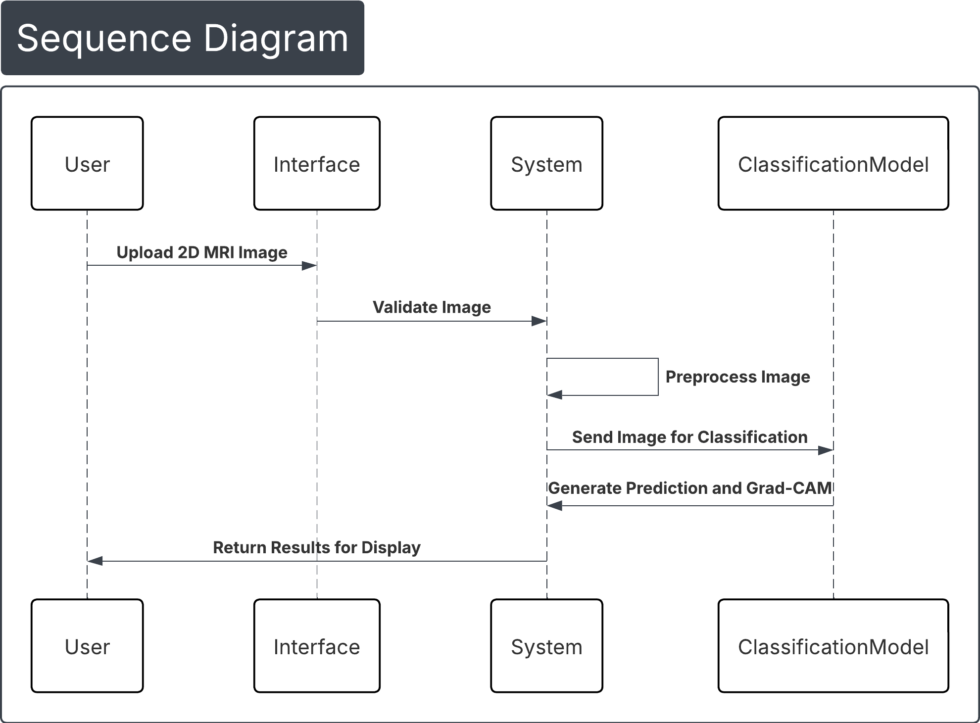
UML Diagram – sequence

Slide 15
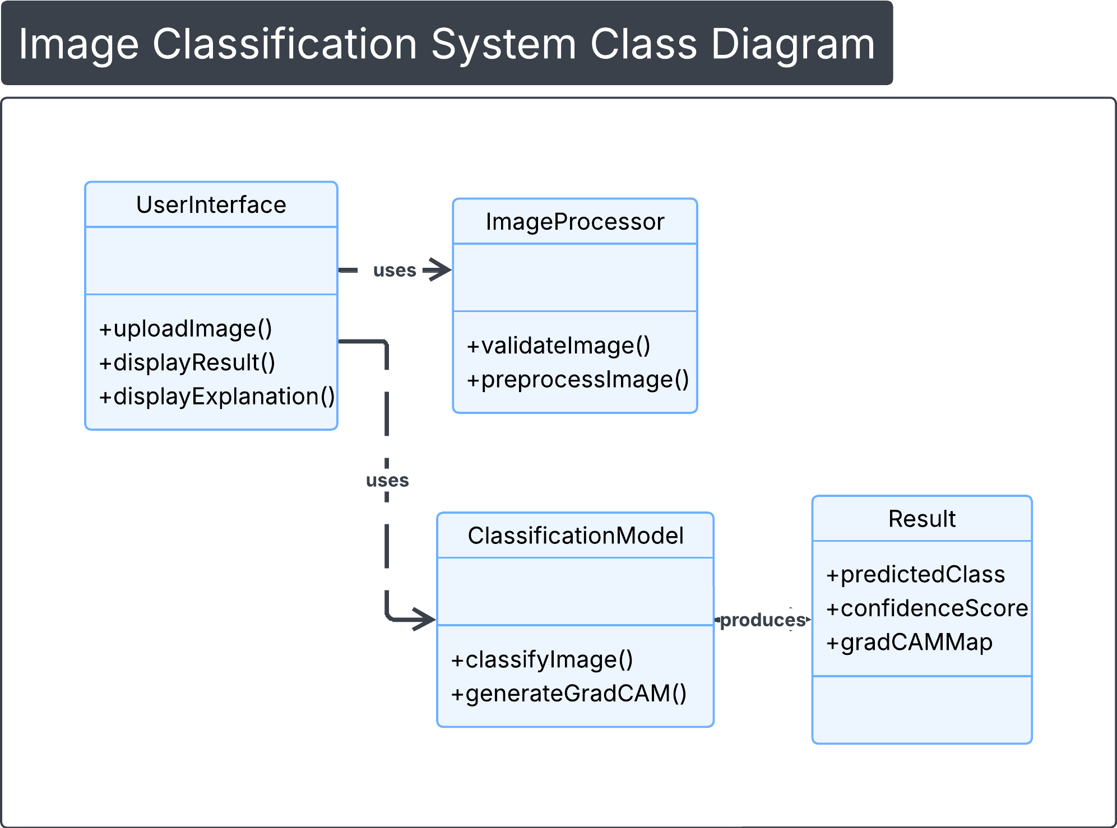
UML Diagram – class

Slide 16
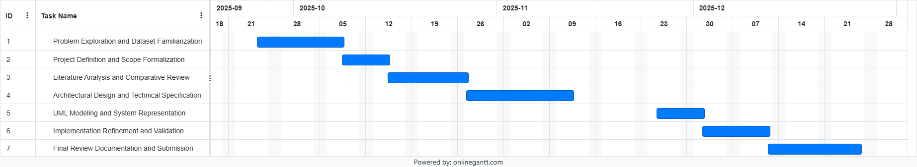
Project Plan – Gantt chart

Slide 17
Conclusion and Future Work
Demonstrated feasible and explainable MRI classification using 2D slices.
Compared efficiency and performance of two CNN approaches.
Future work includes richer datasets, segmentation, and 3D MRI analysis.

Slide 18
References
Almusharraf, A.I. et al. (2024) ‘Refining neural network algorithms for accurate brain tumor classification in MRI imagery’, BMC Medical Imaging, 24, pp. 1–15.
Haque, R. et al. (2024) ‘NeuroNet19: an explainable deep neural network for brain tumor classification using MRI’, Scientific Reports, 14, pp. 1–17.
Howard, A.G. et al. (2018) ‘MobileNetV2: inverted residuals and linear bottlenecks’, Proc. CVPR, pp. 4510–4520.
Kaggle (2025) BRISC2025: Brain MRI for Brain Tumor Classification. Available at: kaggle.com (Accessed: 10 March 2025).
Nazir, M.I. et al. (2024) ‘Customized CNN for brain tumor prediction with explainable AI’, Heliyon, 10, pp. 1–15.
Reyes, D. and Sánchez, J. (2024) ‘CNN performance for brain tumor classification using MRI’, Heliyon, 10, pp. 1–14.
Rasa, S.M. et al. (2024) ‘Brain tumor classification using fine-tuned transfer learning models’, Digital Health, 10, pp. 1–14.
Selvaraju, R.R. et al. (2017) ‘Grad-CAM: visual explanations from deep networks’, Proc. ICCV, pp. 618–626.
Vimala, B.B. et al. (2023) ‘Detection and classification of brain tumor using hybrid deep learning models’, Scientific Reports, 13, pp. 1–16.
Wang, X. et al. (2024) ‘LATUP-Net: a lightweight 3D attention U-Net for brain tumor segmentation’, Computers in Biology and Medicine, 168, 107633.

